Slide 1
COMP 4500
Week 8 - Friday

Slide 2
Last time
What did we talk about last time?
Integer multiplication
Started Master Theorem

Slide 3
Questions?

Slide 4
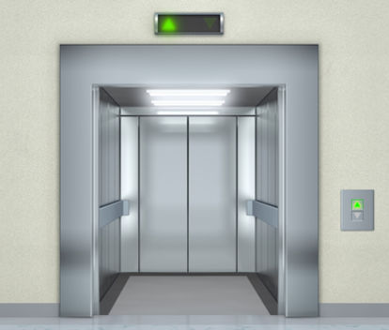
Logical warmup
A man works on the 10th floor of a building
He always takes the elevator straight from the 10th floor to the ground floor at the end of the day
Most mornings, he takes the elevator to the 7th floor and then walks the remaining three flights of stairs up to the 10th floor, even when in a hurry
However, he takes the elevator straight to the 10th floor on mornings when others are in the elevator or when it is raining
Why?

Slide 5
Master Theorem

Slide 6
Master Theorem
Has a great name …
Allows us to determine the Big Theta running time of many recursive functions that would otherwise take more effort to determine

Slide 7
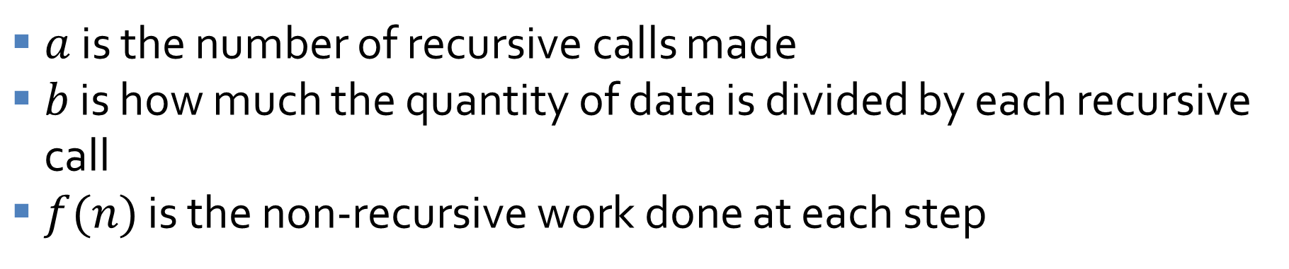
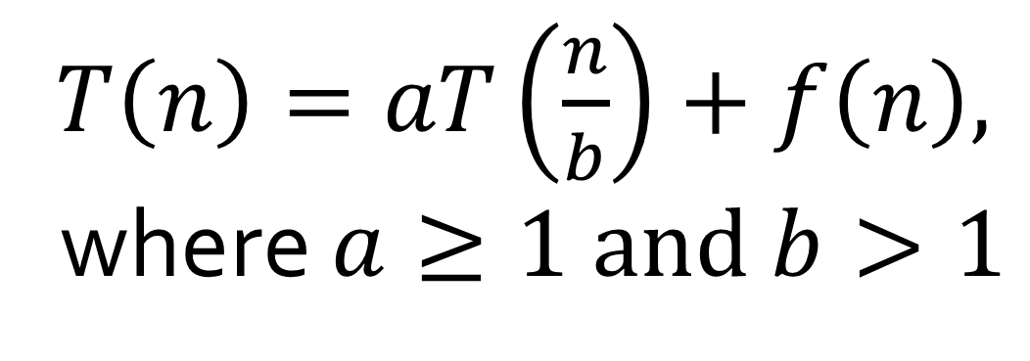
Basic form the recurrence relation must take
$T\left(n\right)=aT\left(\frac{n}{b}\right)+f\left(n\right),$
where $a≥1 and b>1$
$a$ is the number of recursive calls made
$b$ is how much the quantity of data is divided by each recursive call
$f(n)$ is the non-recursive work done at each step

Slide 8
Case 1
If $f\left(n\right) \text{is} O\left(n^{\log_{b}{(a)}−ε}\right)$
for some constant $ε>0$, then
$$T\left(n\right) \text{is} Θ\left(n^{\log_{b}{(a)}}\right)$$

Slide 9
Case 2
If $f\left(n\right) \text{is} Θ\left(n^{\log_{b}{(a)}}\log^{k}{n}\right)$
for some constant $k≥0$, then
$$T\left(n\right) \text{is} Θ\left(n^{\log_{b}{(a)}}\log^{k+1}{n}\right)$$

Slide 10
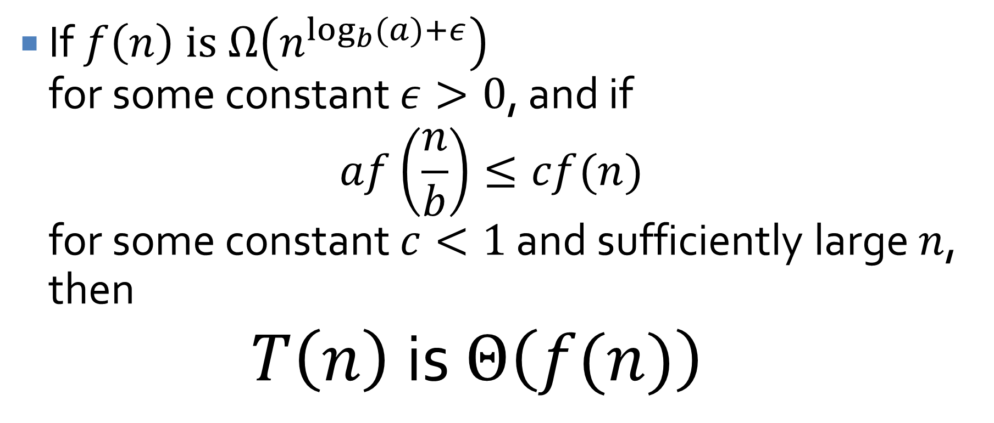
Case 3
If $f\left(n\right) \text{is} Ω\left(n^{\log_{b}{(a)}+ε}\right)$
for some constant $ε>0$, and if
$$af\left(\frac{n}{b}\right)≤cf(n)$$
for some constant $c<1$ and sufficiently large $n$, then
$$T\left(n\right) \text{is} Θ\left(f(n)\right)$$

Slide 11

Binary Search
We know that binary search takes $O(log⁡n)$ time
Can we use the Master Theorem to check that?
What about merge sort?

Slide 12
Practicing the Master Theorem
One way to practice is to try to create a problems that different cases of the Master Theorem apply to
Give a recurrence relation that uses Case 1
Give a recurrence relation that uses Case 2
Give a recurrence relation that uses Case 3

Slide 13
Solved Exercises

Slide 14
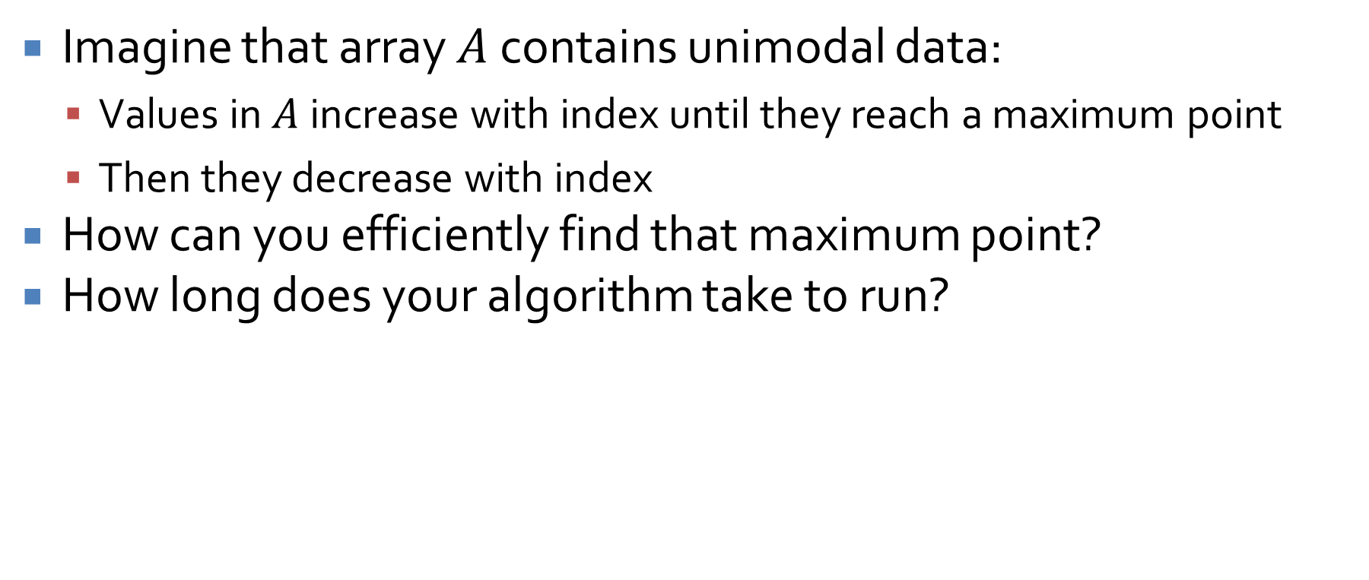
Finding the maximum of unimodal data
Imagine that array $A$ contains unimodal data:
Values in $A$ increase with index until they reach a maximum point
Then they decrease with index
How can you efficiently find that maximum point?
How long does your algorithm take to run?

Slide 15
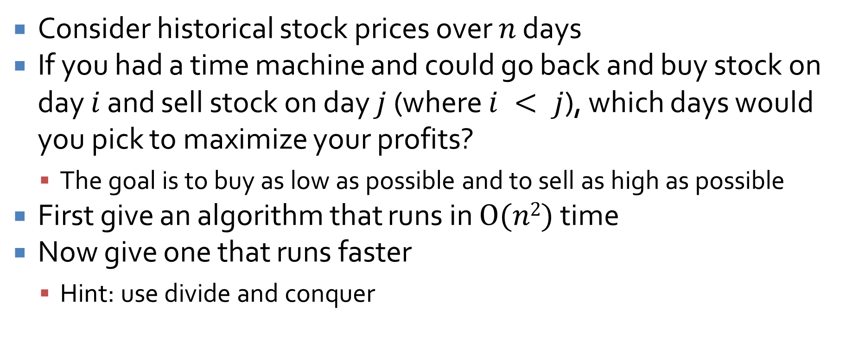
Maximizing stock returns
Consider historical stock prices over $n$ days
If you had a time machine and could go back and buy stock on day $i$ and sell stock on day $j$ (where $i < j$), which days would you pick to maximize your profits?
The goal is to buy as low as possible and to sell as high as possible
First give an algorithm that runs in $O(n2)$ time
Now give one that runs faster
Hint: use divide and conquer

Slide 16
Upcoming

Slide 17
Next time…
Review for Exam 2

Slide 18
Reminders
Finish Assignment 4
Due Monday
Exam 2 is next Wednesday
Review Chapters 4 and 5

